Slide 1


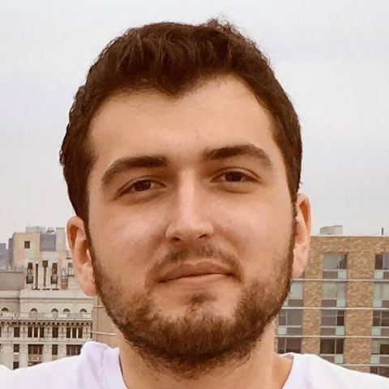

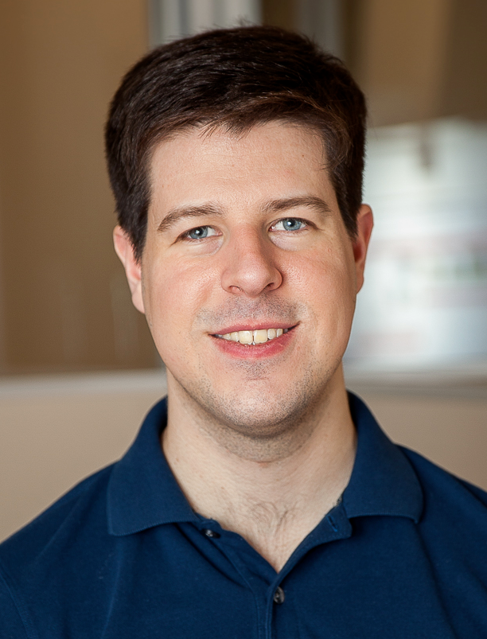

Scalable trust-region method for deep
reinforcement learning using Kronecker-factored approximation
Yuhuai Wu
(K-FAC slides credit to Roger)
Elman
Mansimov
Shun
Liao
Roger
Grosse
Jimmy
Ba

Slide 2
Scalable trust-region method for deep
reinforcement learning using Kronecker-factored approximation
Yuhuai Wu
Paper link: https://arxiv.org/abs/1708.05144
Code release (OpenAI baseline): https://github.com/openai/baselines
My Homepage: http://www.cs.toronto.edu/~ywu/
Twitter: @Yuhu_ai_
github: tonywu95

Slide 3
Overview:
About optimization in general:
The notion of norm/distance.
Natural gradient is Steepest decent + Fisher norm.
K-FAC
Scale up natural gradient using Kronecker-product.
ACKTR
Apply KFAC to A2C.

Slide 4
Introduction: neural net optimization
Most neural networks are still trained using variants of stochastic gradient descent (SGD).
Problem: first-order optimizers like SGD have well-known problems with slow convergence when the curvature is badly conditioned
bounce around a lot in high curvature directions
make slow progress in low curvature directions

Slide 5
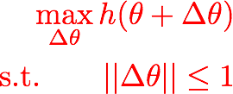
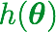
Background: Steepest ascent
Steepest ascent
Euclidean
gradient
gradient ascent
steepest ascent in Euclidean norm
depends on parameterization

Slide 6
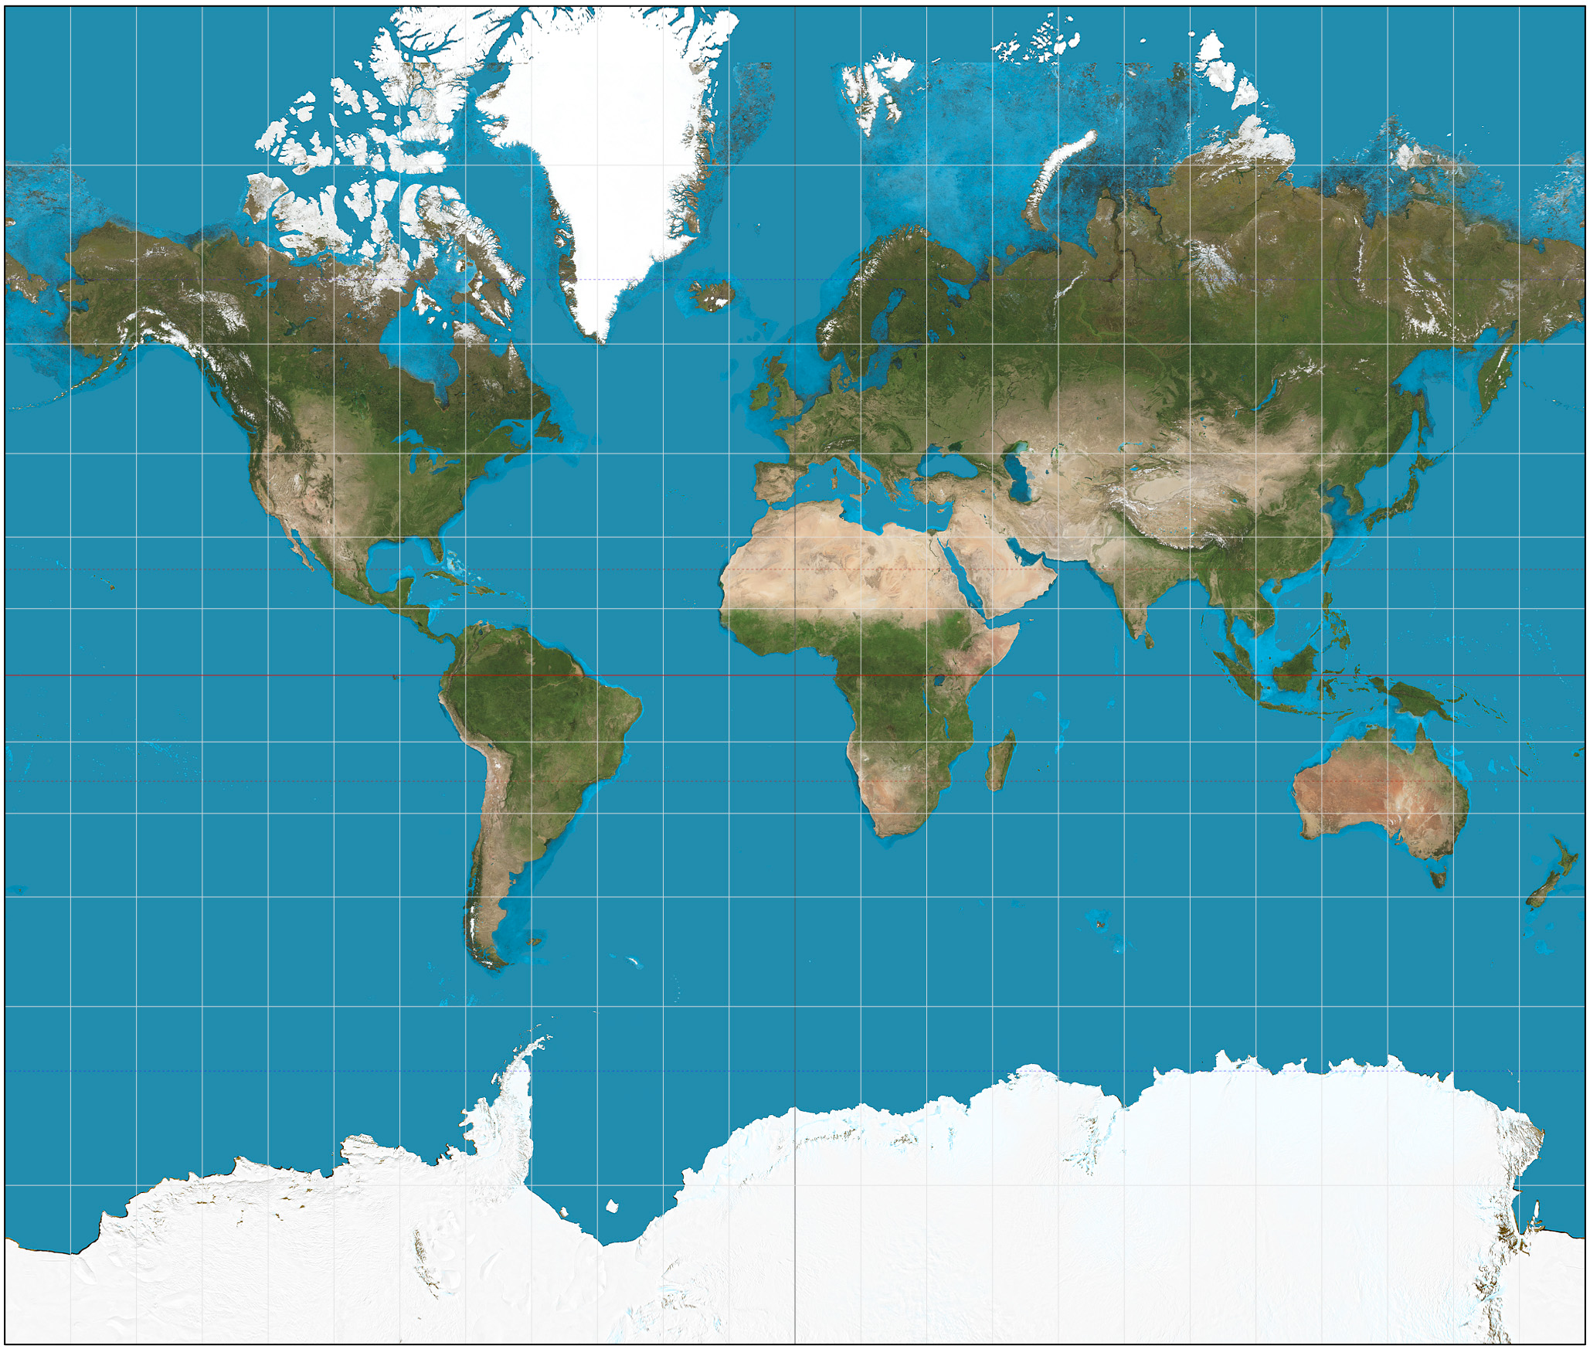

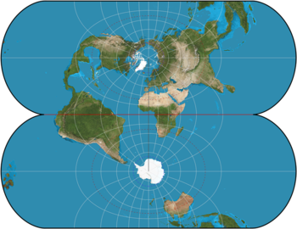
Introduction: neural net optimization
Why do we get elongated optimization objectives?
When we train a network, we’re trying to learn a function, but we
need to parameterize it in terms of weights and biases.
Mapping a manifold to a coordinate system distorts distances
Natural gradient: compute the gradient on the globe, not on the map

Slide 7
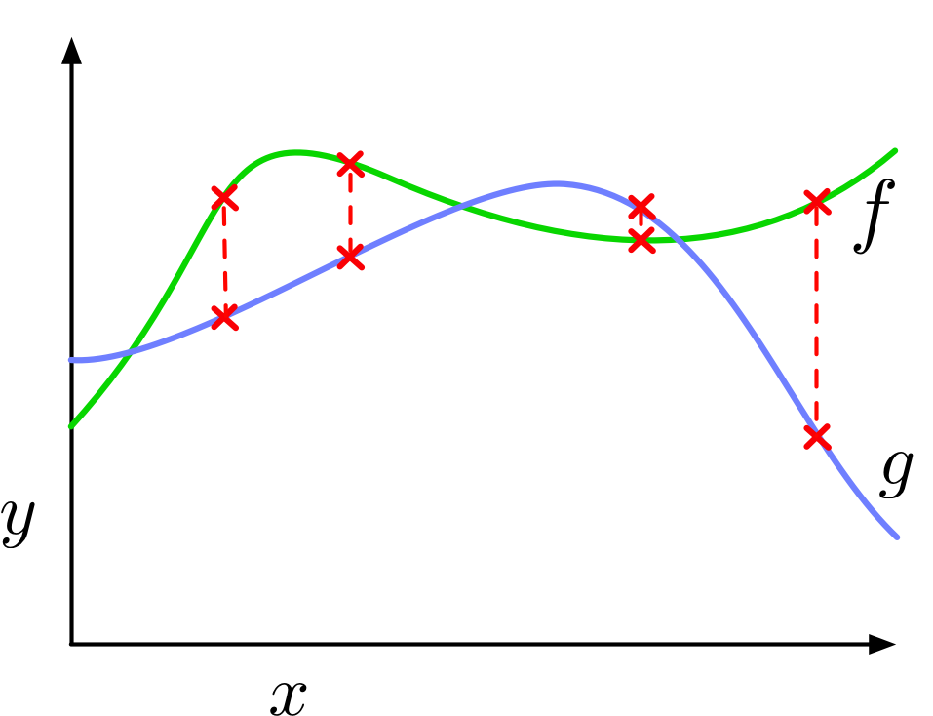
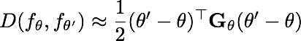
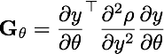
Background: natural gradient
What’s the neural net analogue of distance on the globe?
When we train a neural net, we’re learning a function. How do we define a distance between functions?
Assume we have a dissimilarity metric d on the output space, e.g.
Second-order Taylor approximation:

Slide 8
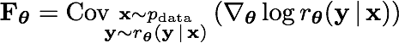
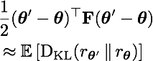
Background: natural gradient
(Amari, 1998)
Many neural networks output a predictive distribution (e.g. over categories).
We can measure the “distance” between two networks in terms of the average KL divergence between their predictive distributions
The Fisher matrix is the second-order Taylor approximation to this average KL:
This equals the covariance of the log-likelihood derivatives:

Slide 9
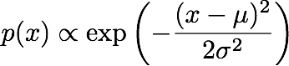
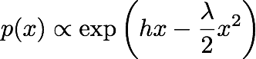
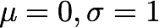
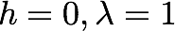
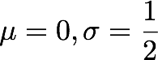
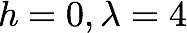
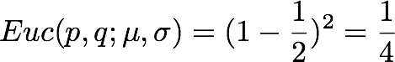
Background: natural gradient
If you phrase your algorithm in terms of KL-Divergence (Fisher information),
it’s invariant to reparameterization.
mean and variance
information form

Slide 10
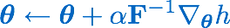
Background: natural gradient
(Amari, 1998)
natural
gradient
gradient ascent
steepest ascent in Euclidean norm
depends on parameterization
Euclidean
gradient
natural gradient ascent
steepest ascent in Fisher norm
F is the Fisher matrix
invariant to parameterization

Slide 11
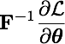
Background: natural gradient
(Amari, 1998)
Problem: dimension of F is the number of trainable parameters
Modern networks can have tens of millions of parameters!
e.g. weight matrix between two 1000-unit layers has 1000 x 1000 = 1 million parameters
Cannot store a dense 1 million x 1 million matrix, let alone compute

Slide 12
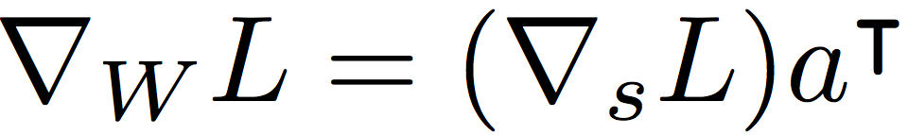
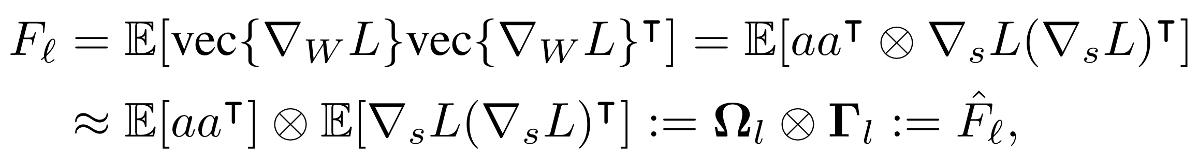
Kronecker-Factored Approximate Curvature (K-FAC)
The derivative w.r.t. a matrix W is:
Hence, the l^th Fisher Block matrix is given by:
where the approximation is based on the previous assumption.

Slide 13
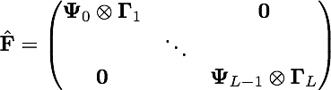
Kronecker-Factored Approximate Curvature (K-FAC)
Therefore, under these assumptions,
By exploiting the following identities:
and
We can efficiently compute the K-FAC update:

Slide 14
Kronecker Factors for CNNs, RNNs
K-FAC can also be applied to CNNs, RNNs.
KFC (Kronecker Factors for CNNs) are proposed in
“A Kronecker-factored approximate Fisher Matrix for convolution layers”
by Grosse & Martens, 2016 Kronecker Factors for RNNs are explored by Jimmy Ba, James Martens (arXiv soon).

Slide 15
Reinforcement Learning
We’d like to achieve sample efficient RL without sacrificing computational efficiency.
One way is to use a better optimizer, which extracts more information from batches of samples.
TRPO approximates the natural gradient using conjugate gradient, similarly to Hessian-free optimization
very efficient in terms of the number of parameter updates
but requires an expensive iterative procedure for each update
only uses curvature information from the current batch

Slide 16
ACKTR!
Actor-critic Kronecker-factored
Trust Region method

Slide 17
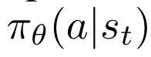
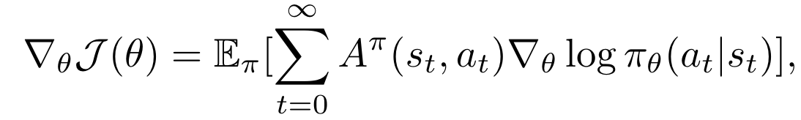
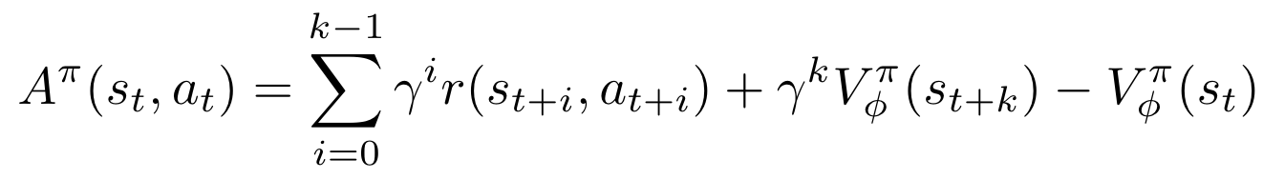
Actor-critic methods
Goal: maximizing expected sum of discounted rewards, with respect to the policy .
Policy gradient: In A3C*,
*A3C: Asynchronous Methods for Deep Reinforcement Learning, Mnih et. al.

Slide 18
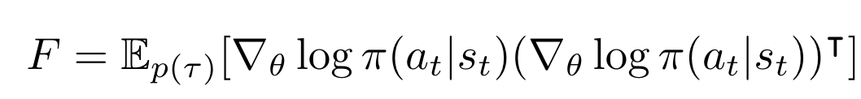
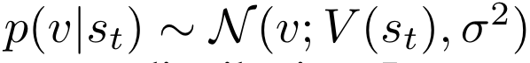
Method: how to construct Fisher Matrix?
For Actor:
Using policy distribution for actor network (natural policy gradient, Kakade, 2003.)
For Critic:
Assume Normal output distribution:
Equivalent to Gauss-Newton metric.

Slide 19
Method
Adopted distributed implementation of K-FAC (Ba, et. al., 2017).
Asynchronously computes matrix inverses.
re-scale updates using trust region method, analogously to TRPO
approximate the KL using the Fisher metric.
Using a moving average to accumulate Fisher statistics, in order to get a better estimate of the curvature.

Slide 20
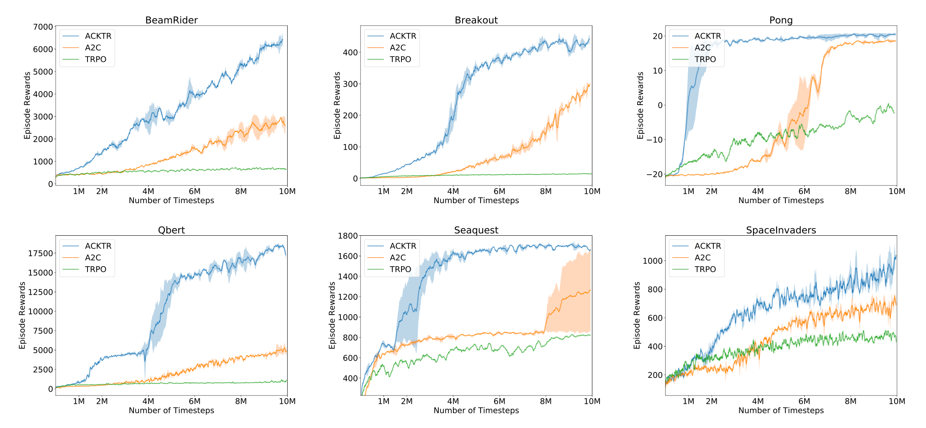
Results
Atari games:

Slide 21


Results
Atari games:

Slide 22
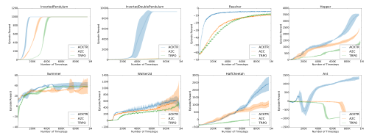
Results
MuJoCo (state space)

Slide 23
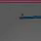
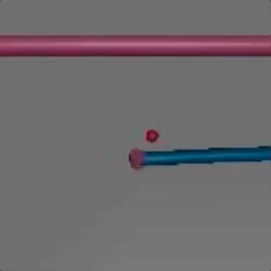
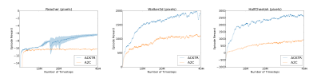
Directly from pixel inputs on Mujoco

Slide 24
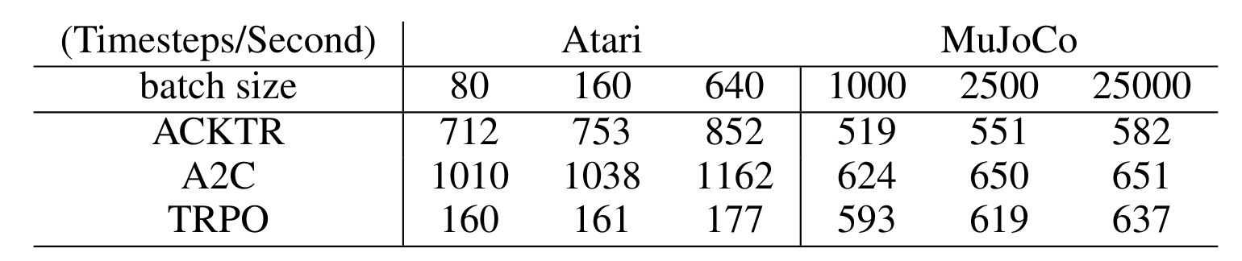
Wall clock time?
Only increase 10-25% computation time.

Slide 25
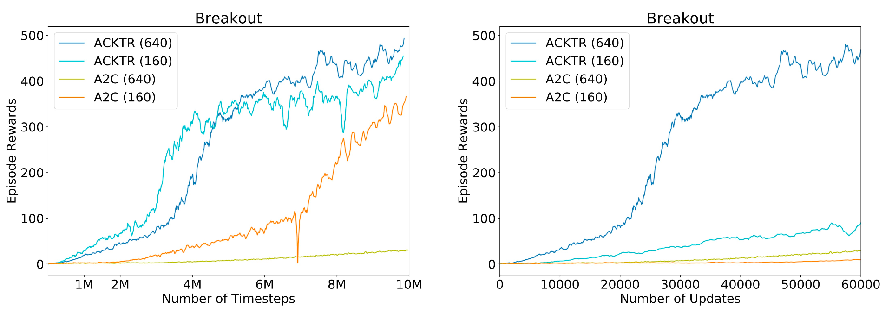
Batchsize effect

Slide 26
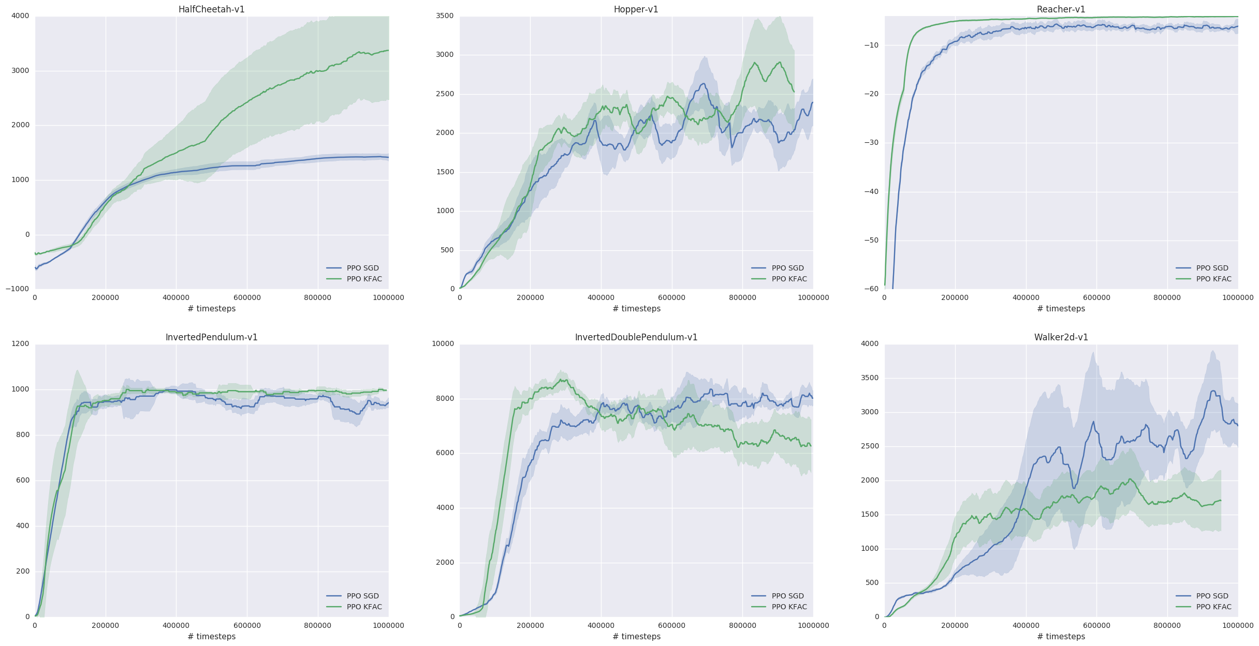
Results with PPO*
MuJoCo
KFAC: epochs 2, number of mini-batches: 1
SGD: epochs 10, number of mini-batches: 32
SGD needs to do 160X number of updates to catch up with K-FAC!
*work done with Jiaming Song at OpenAI.

Slide 27
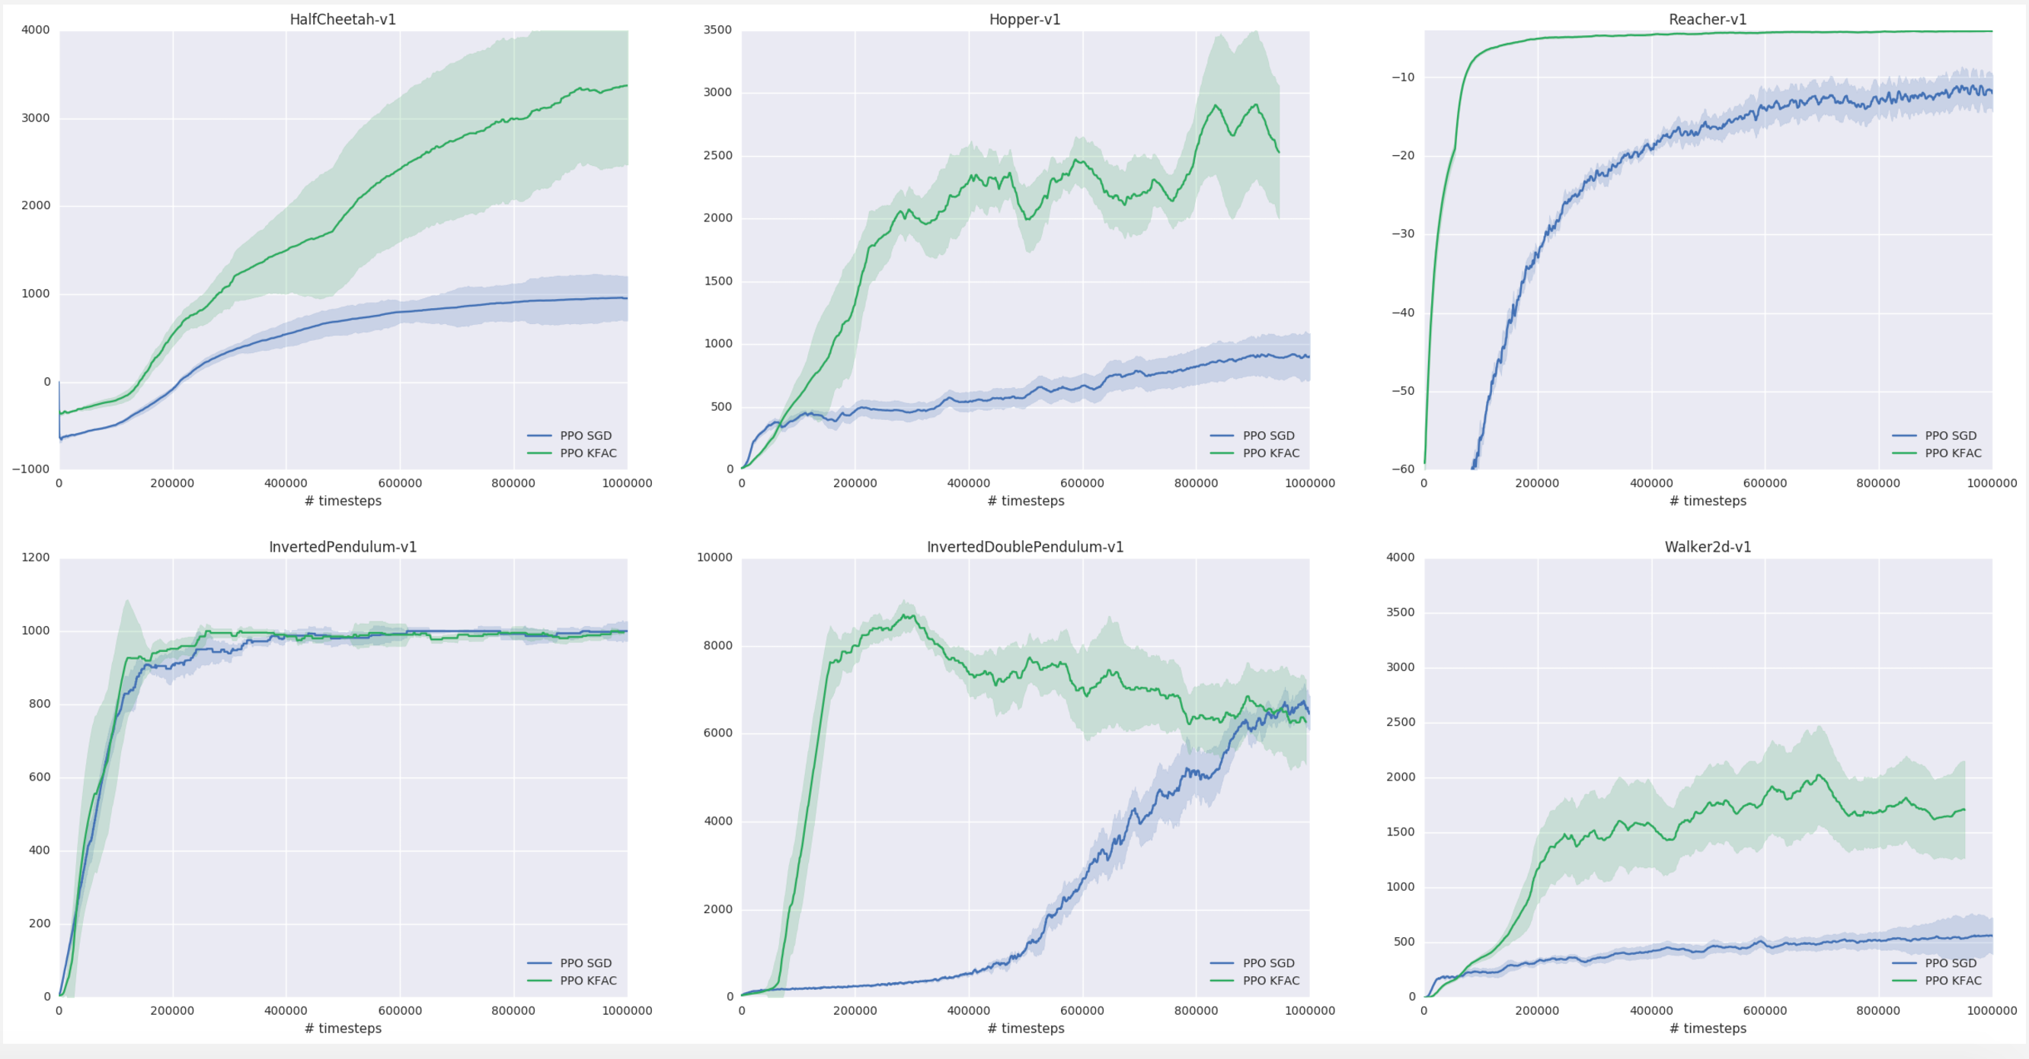
Results with PPO*
MuJoCo
Same number updates per sample:
*work done with Jiaming Song at OpenAI.

Slide 28
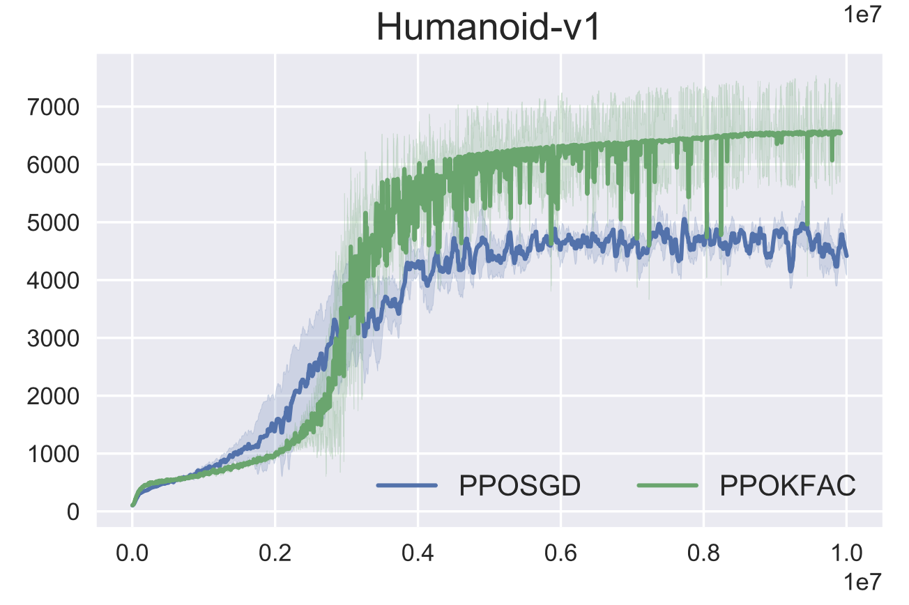
Results with PPO*
MuJoCo Humanoid
*work done with Jiaming Song at OpenAI.

Slide 29
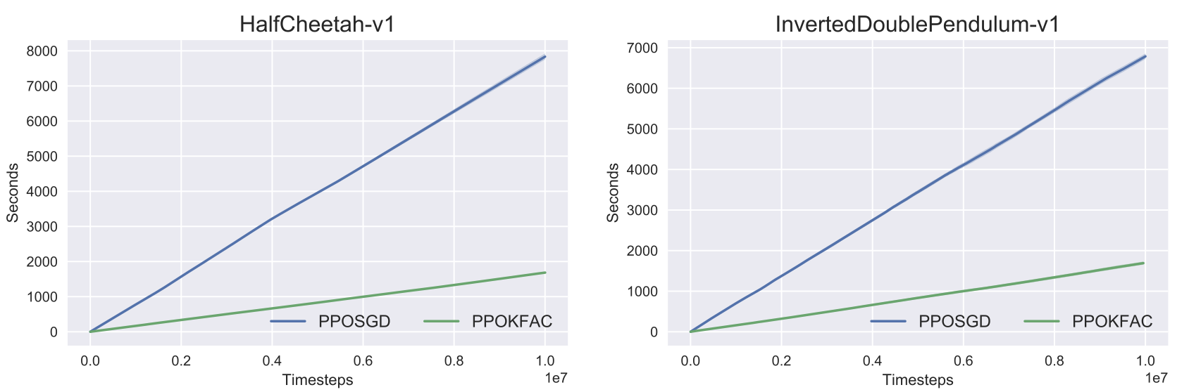
Results with PPO*
Computing time: 3-4X faster.
*work done with Jiaming Song at OpenAI.

Slide 30
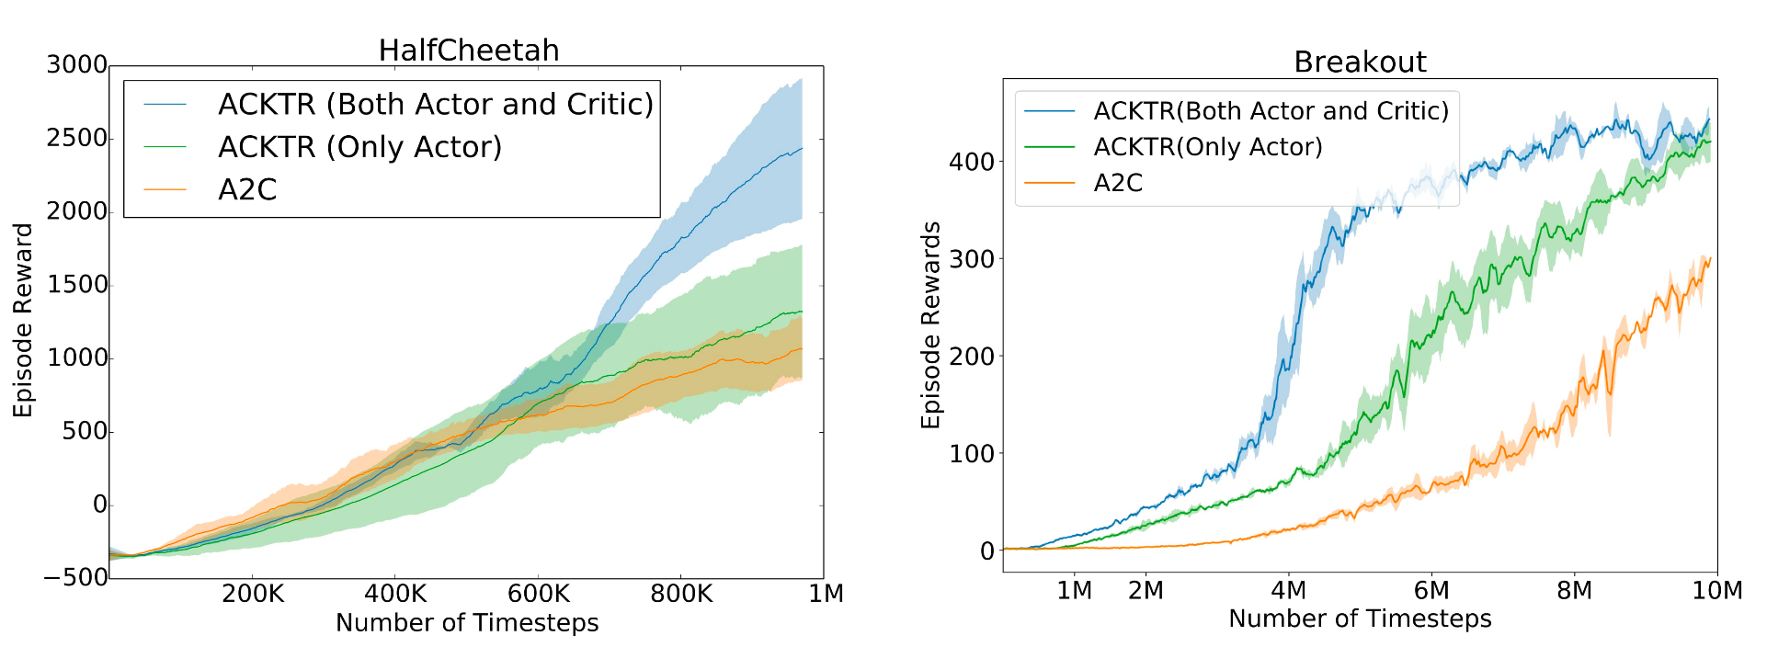
Critic optimization

Slide 31
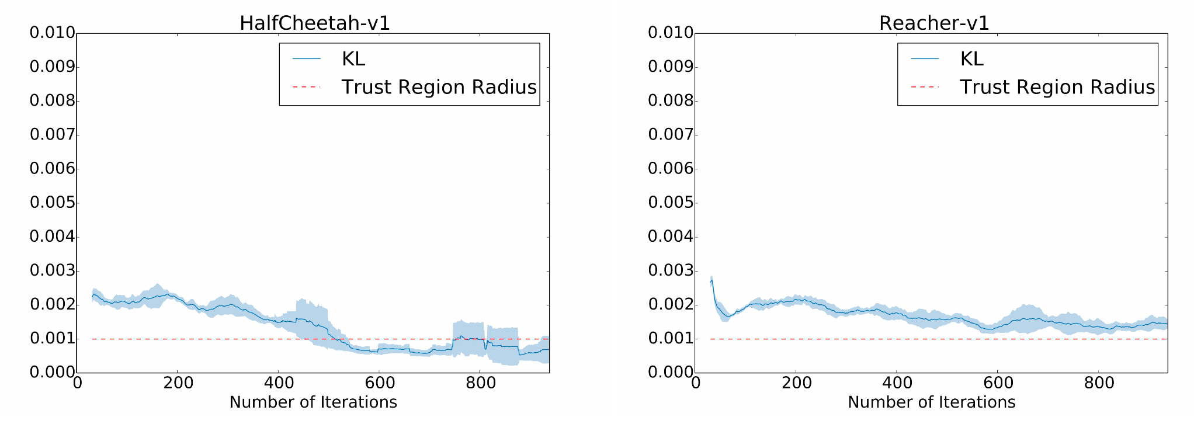
Does it really do trust region?

Slide 32
Conclusions
Natural gradient is independent of the parameterization. K-FAC is a scalable approximate natural gradient algorithm.
ACKTR is 2-3X improvement in sample efficiency than A2C.
ACKTR can learn both continuous and discrete control tasks from pixel inputs.
ACKTR only takes 10-25% longer computation.
ACKTR is able to use batch size more efficiently.
Optimizing critic with Kronecker approximated Gauss-Newton is useful!
K-FAC approximation helps trust region.
PPO is not an competitor.
With KFAC optimizer, 3-4X speedup in computation time.
Significant improvement in Humanoid and other tasks.

Slide 33
Coming soon…
K-FAC on other RL algorithms…
K-FAC with Q-learning.
K-FAC with DDPG.
K-FAC with PPO.
Stay tuned!!!

Slide 34
Thank you!

